Slide 1

Delhi Skill and Entrepreneurship University
Dwarka Campus (Integrated Institute of Technology)
Dwarka Sector 9, Dwarka, Delhi, 110077
Summer Training Evaluation (CS-SI501) (5th Semester)
Submitted by-
Abhishek Roka (10621019)
Under the supervision of -
Mr. Virendar Dagar
(Assistant Professor, DSEU, Dwarka)

Slide 2


My Summer Internship
Peek view to my internship journey

Slide 3
Introduction
Duration: 1st August to 31st August, 2023
Nature: Remote Work from Home internship
Platform: CodSoft, a dynamic hub for software development and innovation

Slide 4
Overview
The summer internship at CodSoft was a pivotal chapter in my journey to enhance my Python programming skills and delve into the realm of Graphical User Interface (GUI) development. This dynamic experience unfolded over the span of a month, offering a flexible and enriching learning environment.

Slide 5
Objectives
The primary objectives of the internship were:
Hands-on Python Programming: To polish Python programming skills through practical applications.
GUI Development: To gain proficiency in designing and implementing intuitive Graphical User Interfaces.
Project Flexibility: To choose and complete three out of five assigned projects, each tailored to personal interests and career goals.

Slide 6


Tasks and Responsibilities
GitHub Repository Management
Version-controlled repositories for projects
Creating GUIs
LinkedIn Engagement
Designing intuitive Python GUIs
Documenting progress, insights on LinkedIn

Slide 7
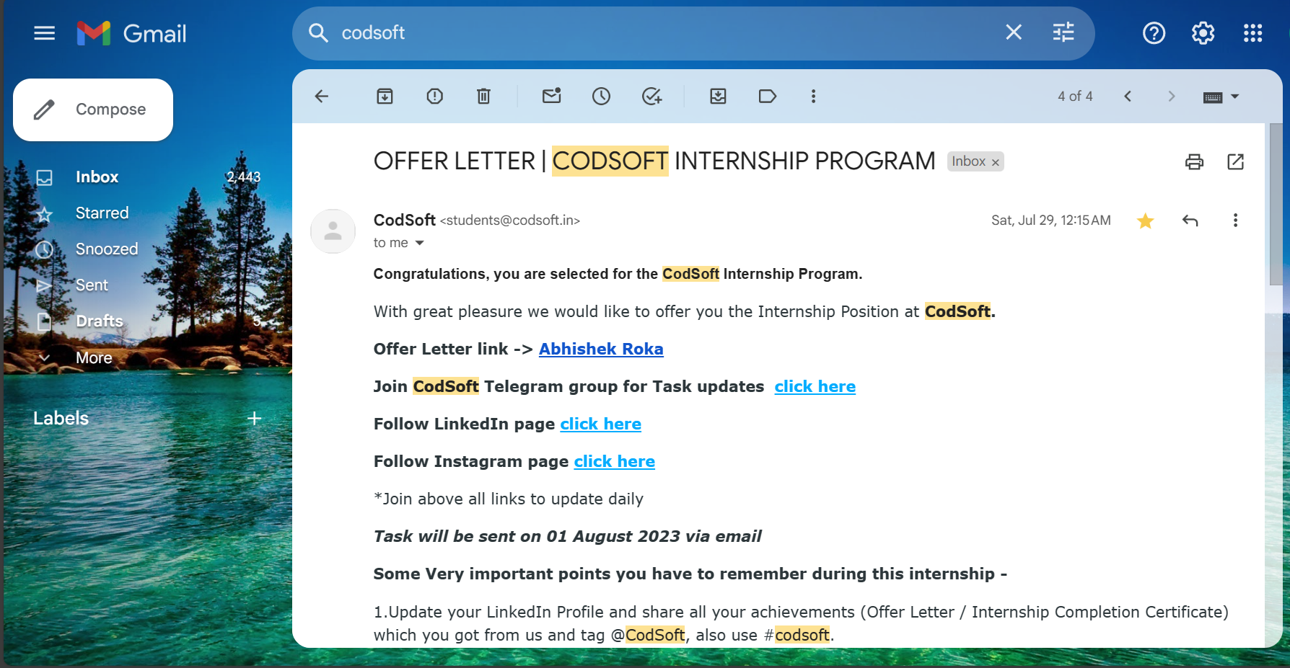
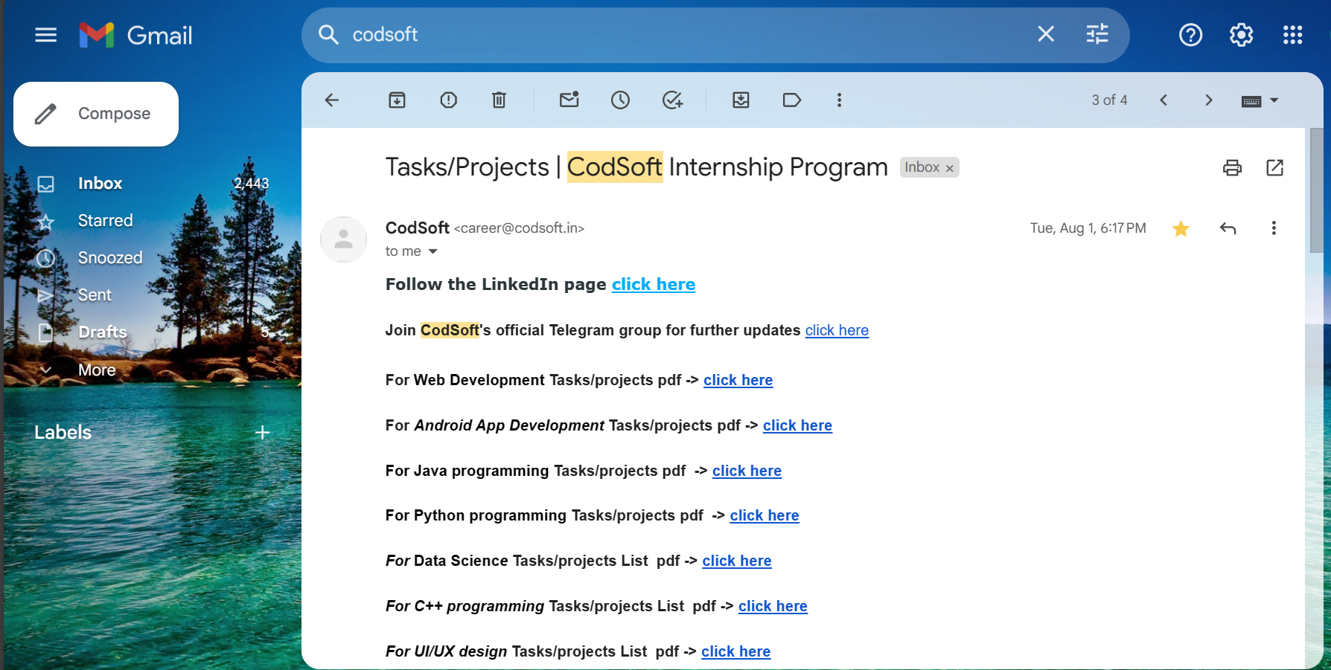
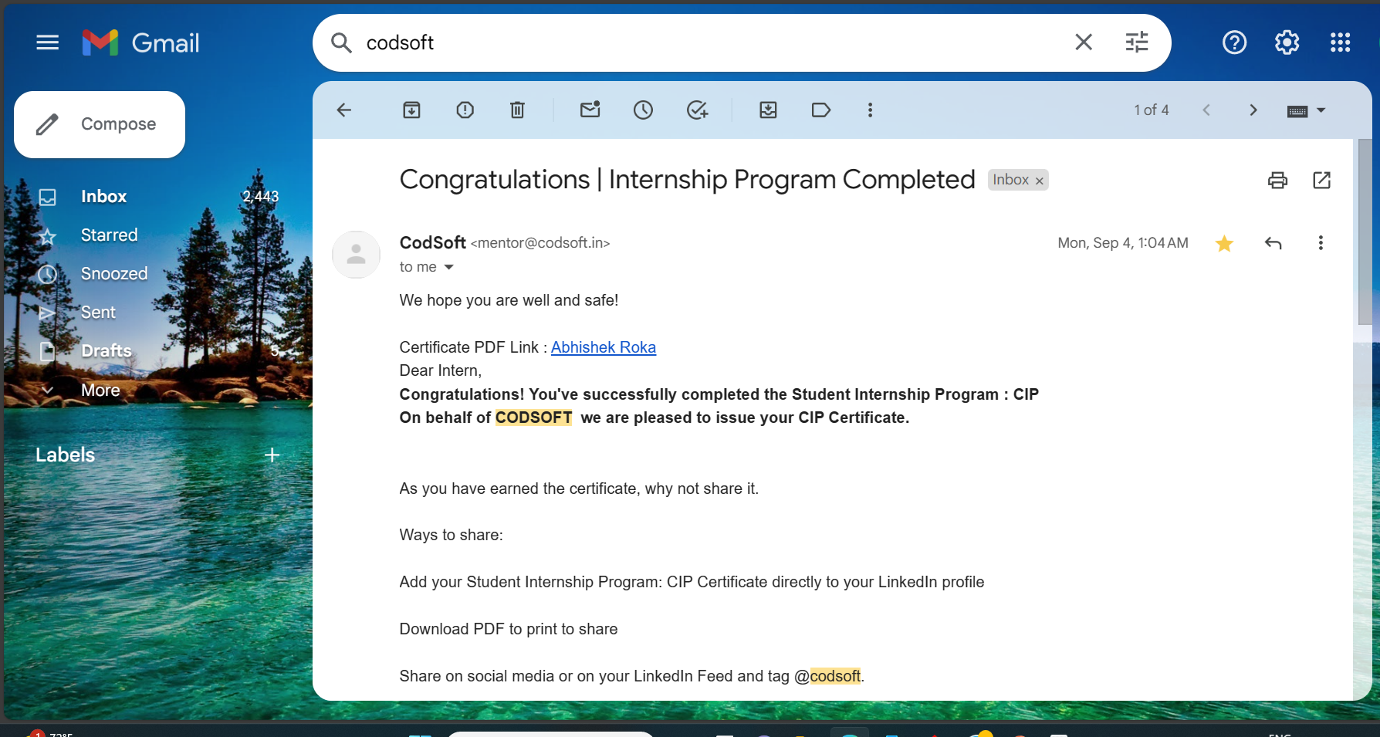
Glimpse to Internship
Work Emails

Slide 8
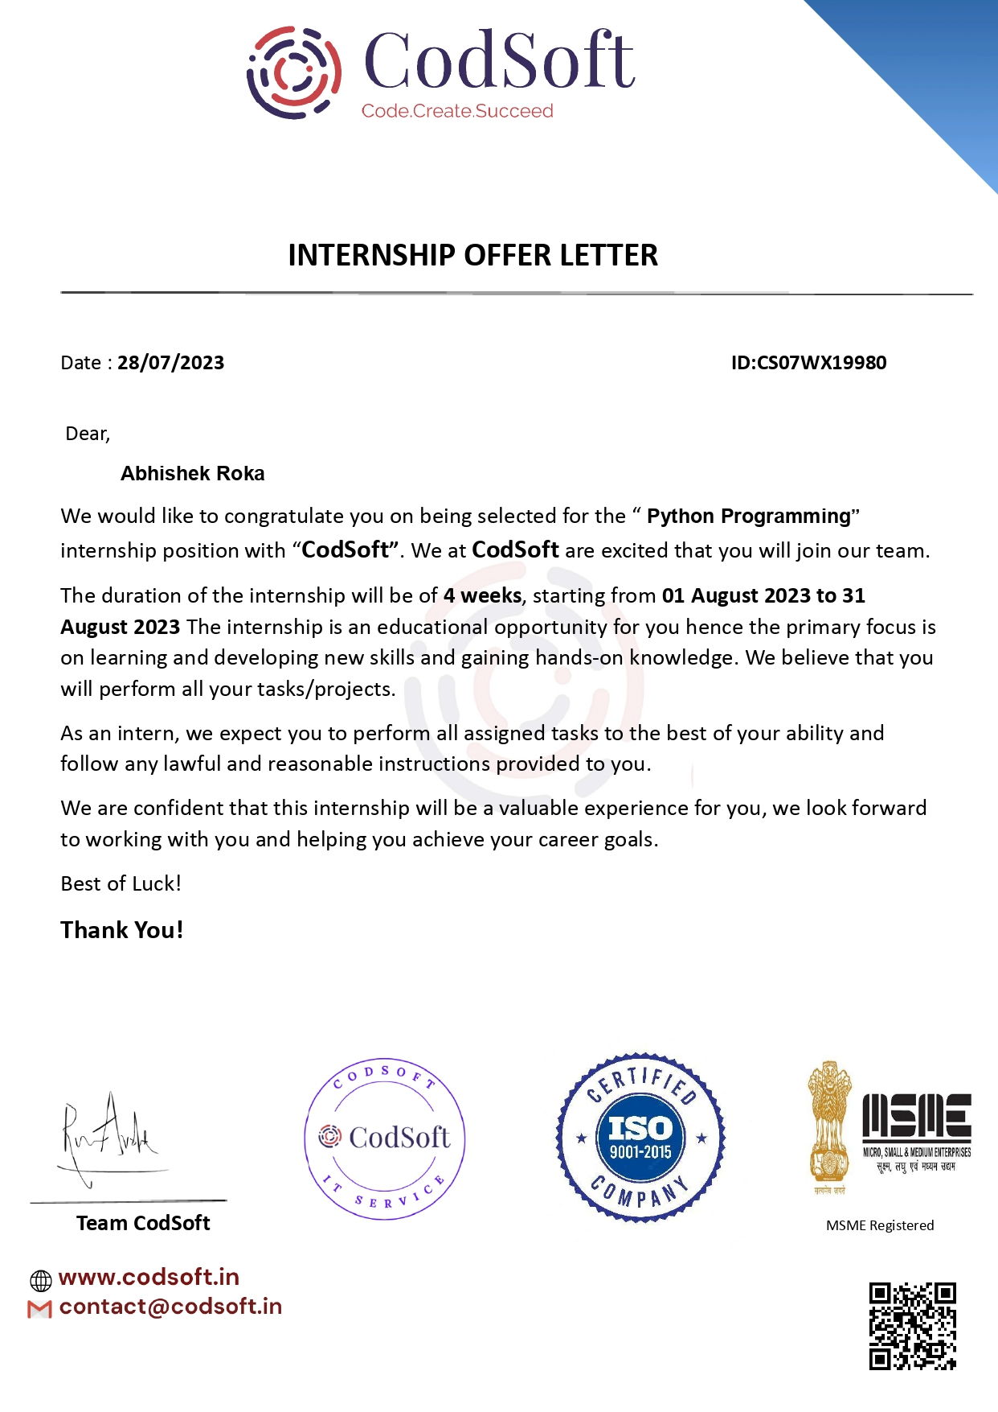
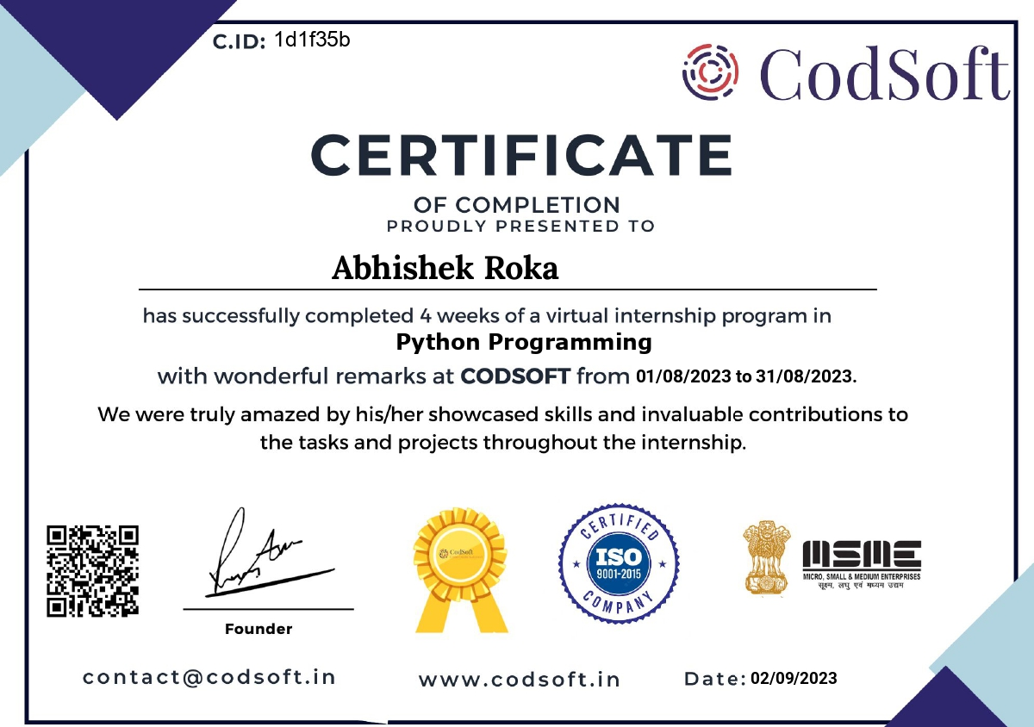
Offer letter and Completion Certificate

Slide 9

Key learnings
1
GUI
Effective GUI design principles
2
Logic
Application of logic in software development
3
Version Control
Collaborative coding practices and version control

Slide 10


